Slide 1
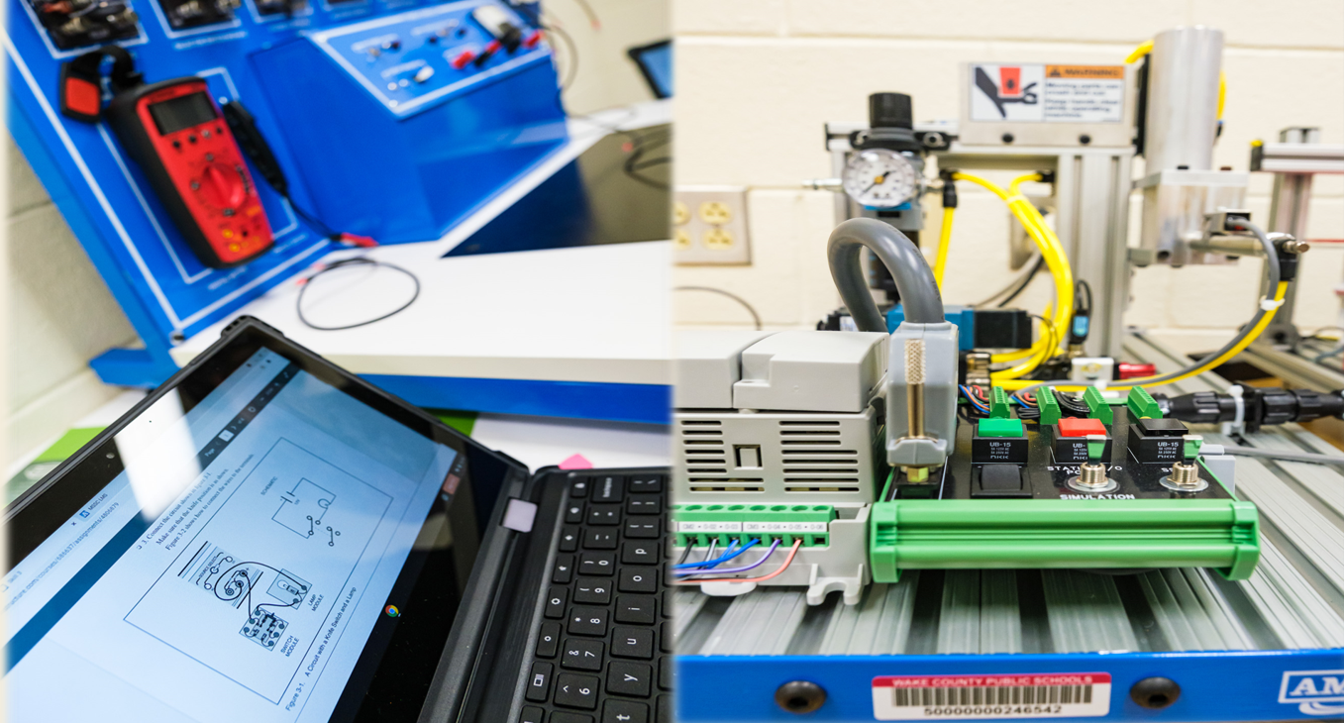
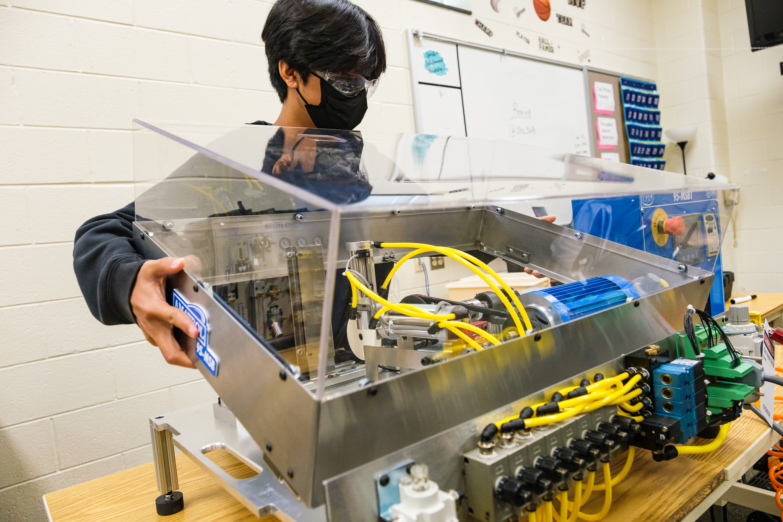

Slide 2
What is the Academy of Technology & Advanced Manufacturing(ATAM)?

Slide 3
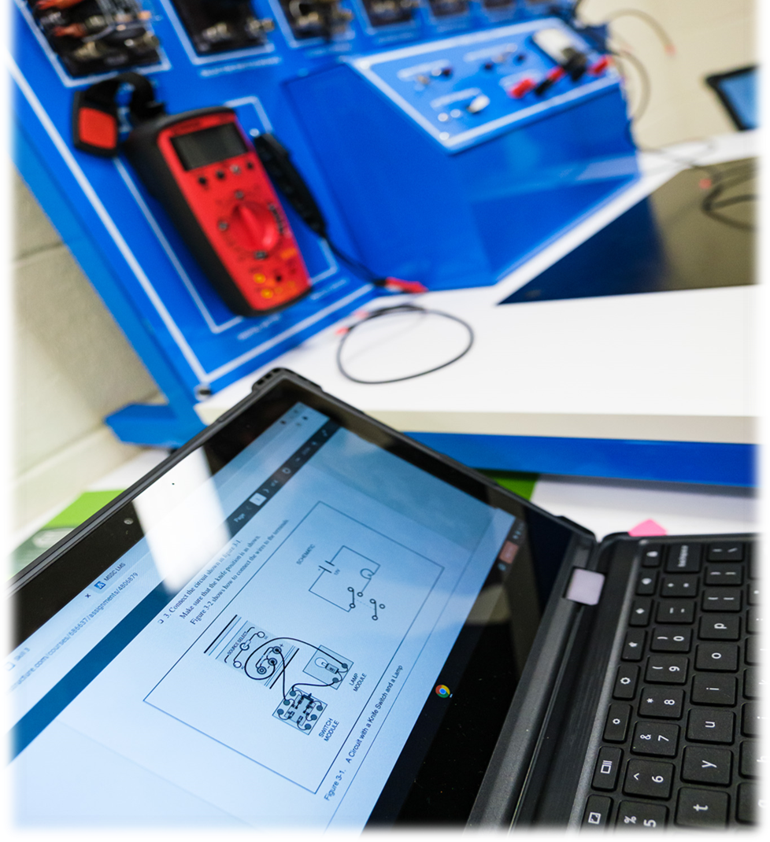
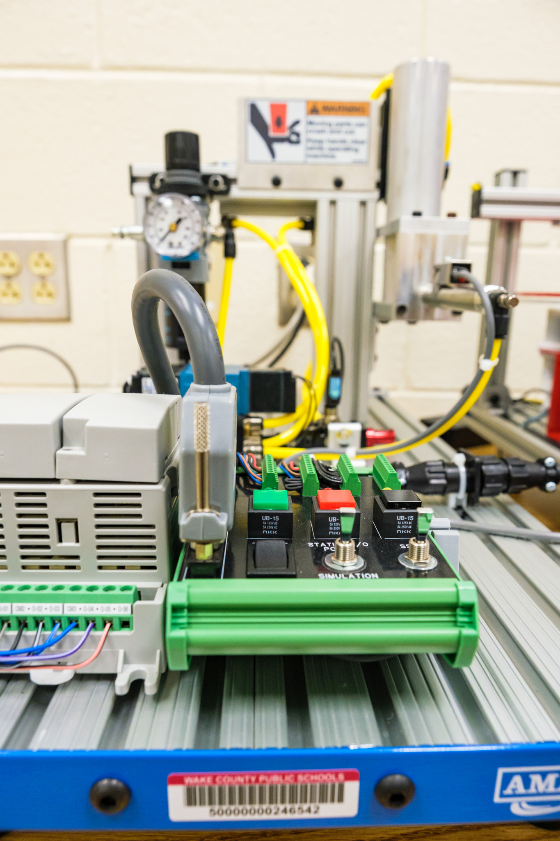
An Opportunity For An Incredible Educational Experience For Cary High Students!!

Slide 4
Cary High School ATAM is a smaller inclusive learning community within Cary High School that focuses on a career theme that is aligned with the needs of the local and state workforce and is integrated into the curriculum.
Twenty first century workplace, employability and soft skills are integrated within the program(Resume Writing, Mock Interviews, Job Shadows, Business Immersions, Internships Apprenticeships…etc.).
Student take core and Career and Technical Education classes together as a cohort
The program uses the integration of STEM principles, interdisciplinary, and co-curricular projects to prepare students for life and the workplace
Emphasis is placed on the importance of problem-solving, presentation, communication, teamwork, technology and employability skills
Academy acts as a bridge from the school system to the workplace
Career academies, educators, and the business community become partners investing in and developing today’s youth
Academy Director – John Evans
Email: jevans3@wcpss.net
Cary High School
919 460-3549 Ext. 21832

Slide 5
Opportunity for your child to be Part of:
A learning environment that is collaborative and fun!!
A group that has stronger relationships with their teachers!!
A small learning community where students have built-in support!!

Slide 6
What former students say about being part of an academy!
Senior Katie Beekman, says, “ AOIT has been the greatest part of my high school experience. The field trips and project are unforgettable, the lessons learned are important skills I will use for forever, and the friendships become ones that last a lifetime! AOIT is a family.
10th grader Shelby Poliachik says, AOIT isn’t just about technology. It’s about community; you learn to work together with both your friends and your teachers and have fun doing it.
Academy Director – John Evans
Email: jevans3@wcpss.net
Cary High School
919 460-3549 Ext. 21832

Slide 7
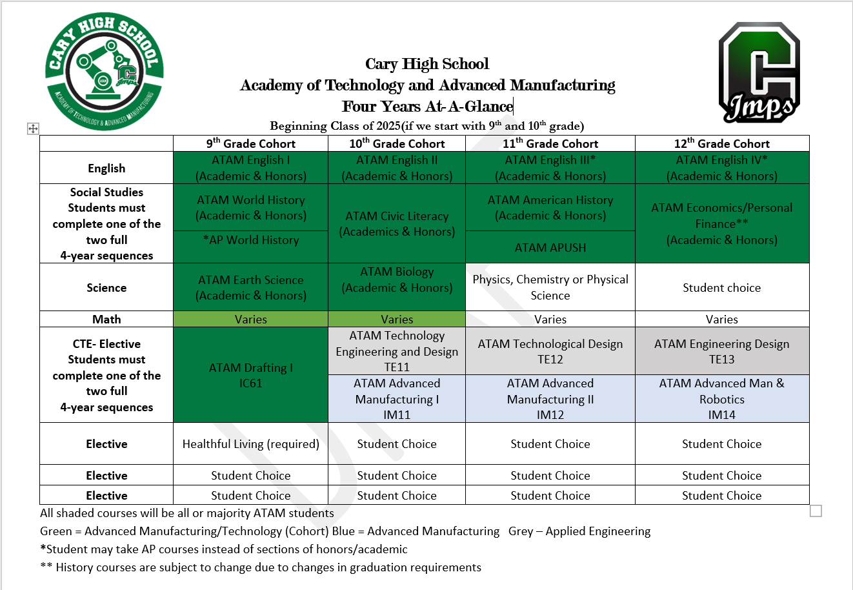
Proposed Course Sequencing

Slide 8
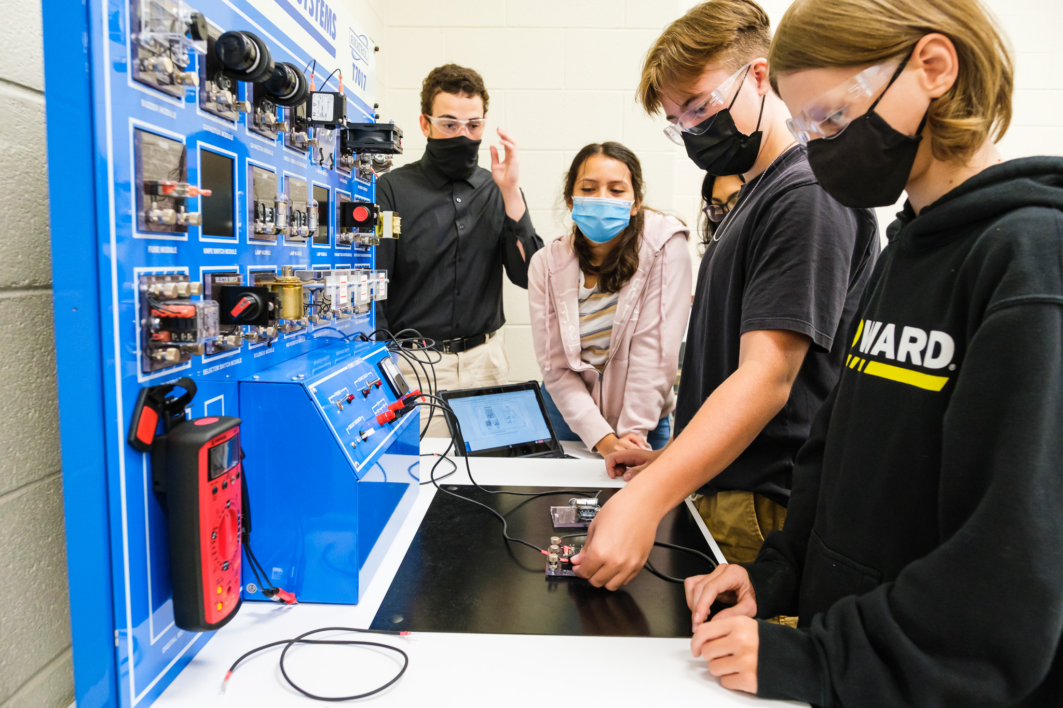
Opportunity for your child to Learn & Earn:
Earn Industry recognized certs that will boost your earnings power!!
Learn employability and soft skills that will put them ahead of their peers!!
Learn high demand technology, design, engineering and manufacturing skills!!

Slide 10
Because of this Opportunity Students Will:
Participate in fieldtrips and unique learning opportunities!!
Learn to think critically and problem solve!!
Be part of a group that is like family!!!
Have access to a professional network!!

Slide 11
Because of this Opportunity Students Will:
Have access to internships and apprenticeships!!
Have access to well paying jobs upon graduation!!
Be prepared for career, college or whatever their next steps are!!
Have fun and leave the academy a more confident prepared person!!

Slide 12
Partners We Have Engaged With:

Slide 13
Being in an Academy Translates Into Success!!

Slide 14
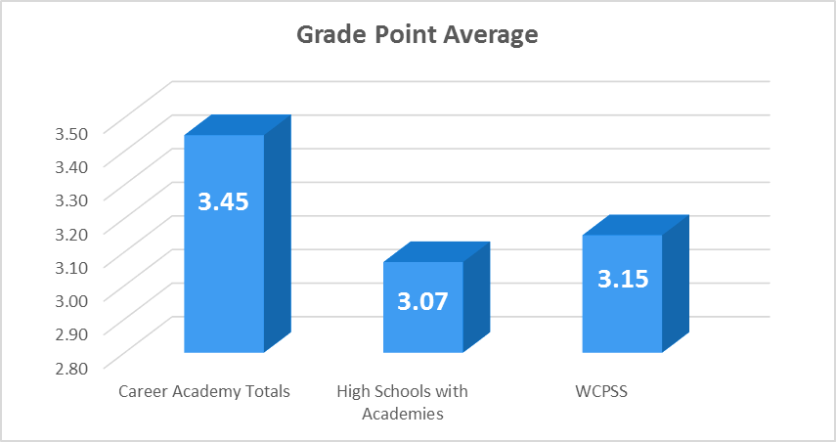
Being in an Academy Translates Into Success!!

Slide 15
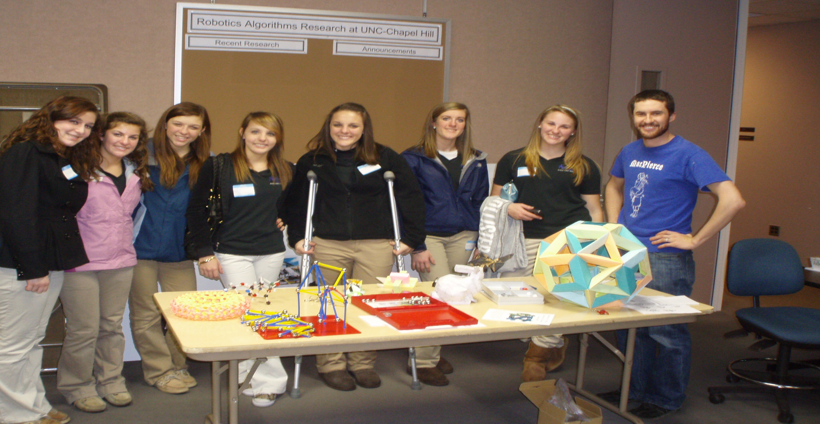
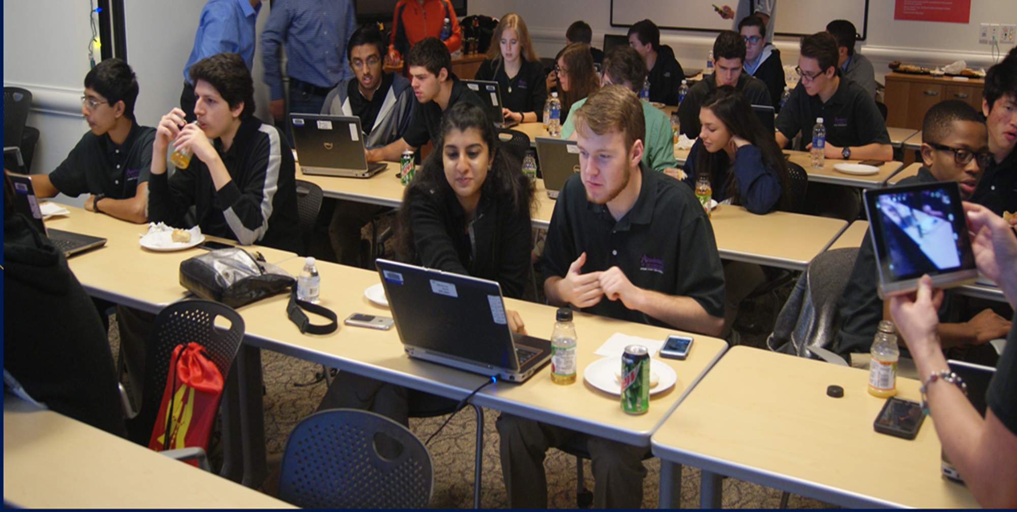
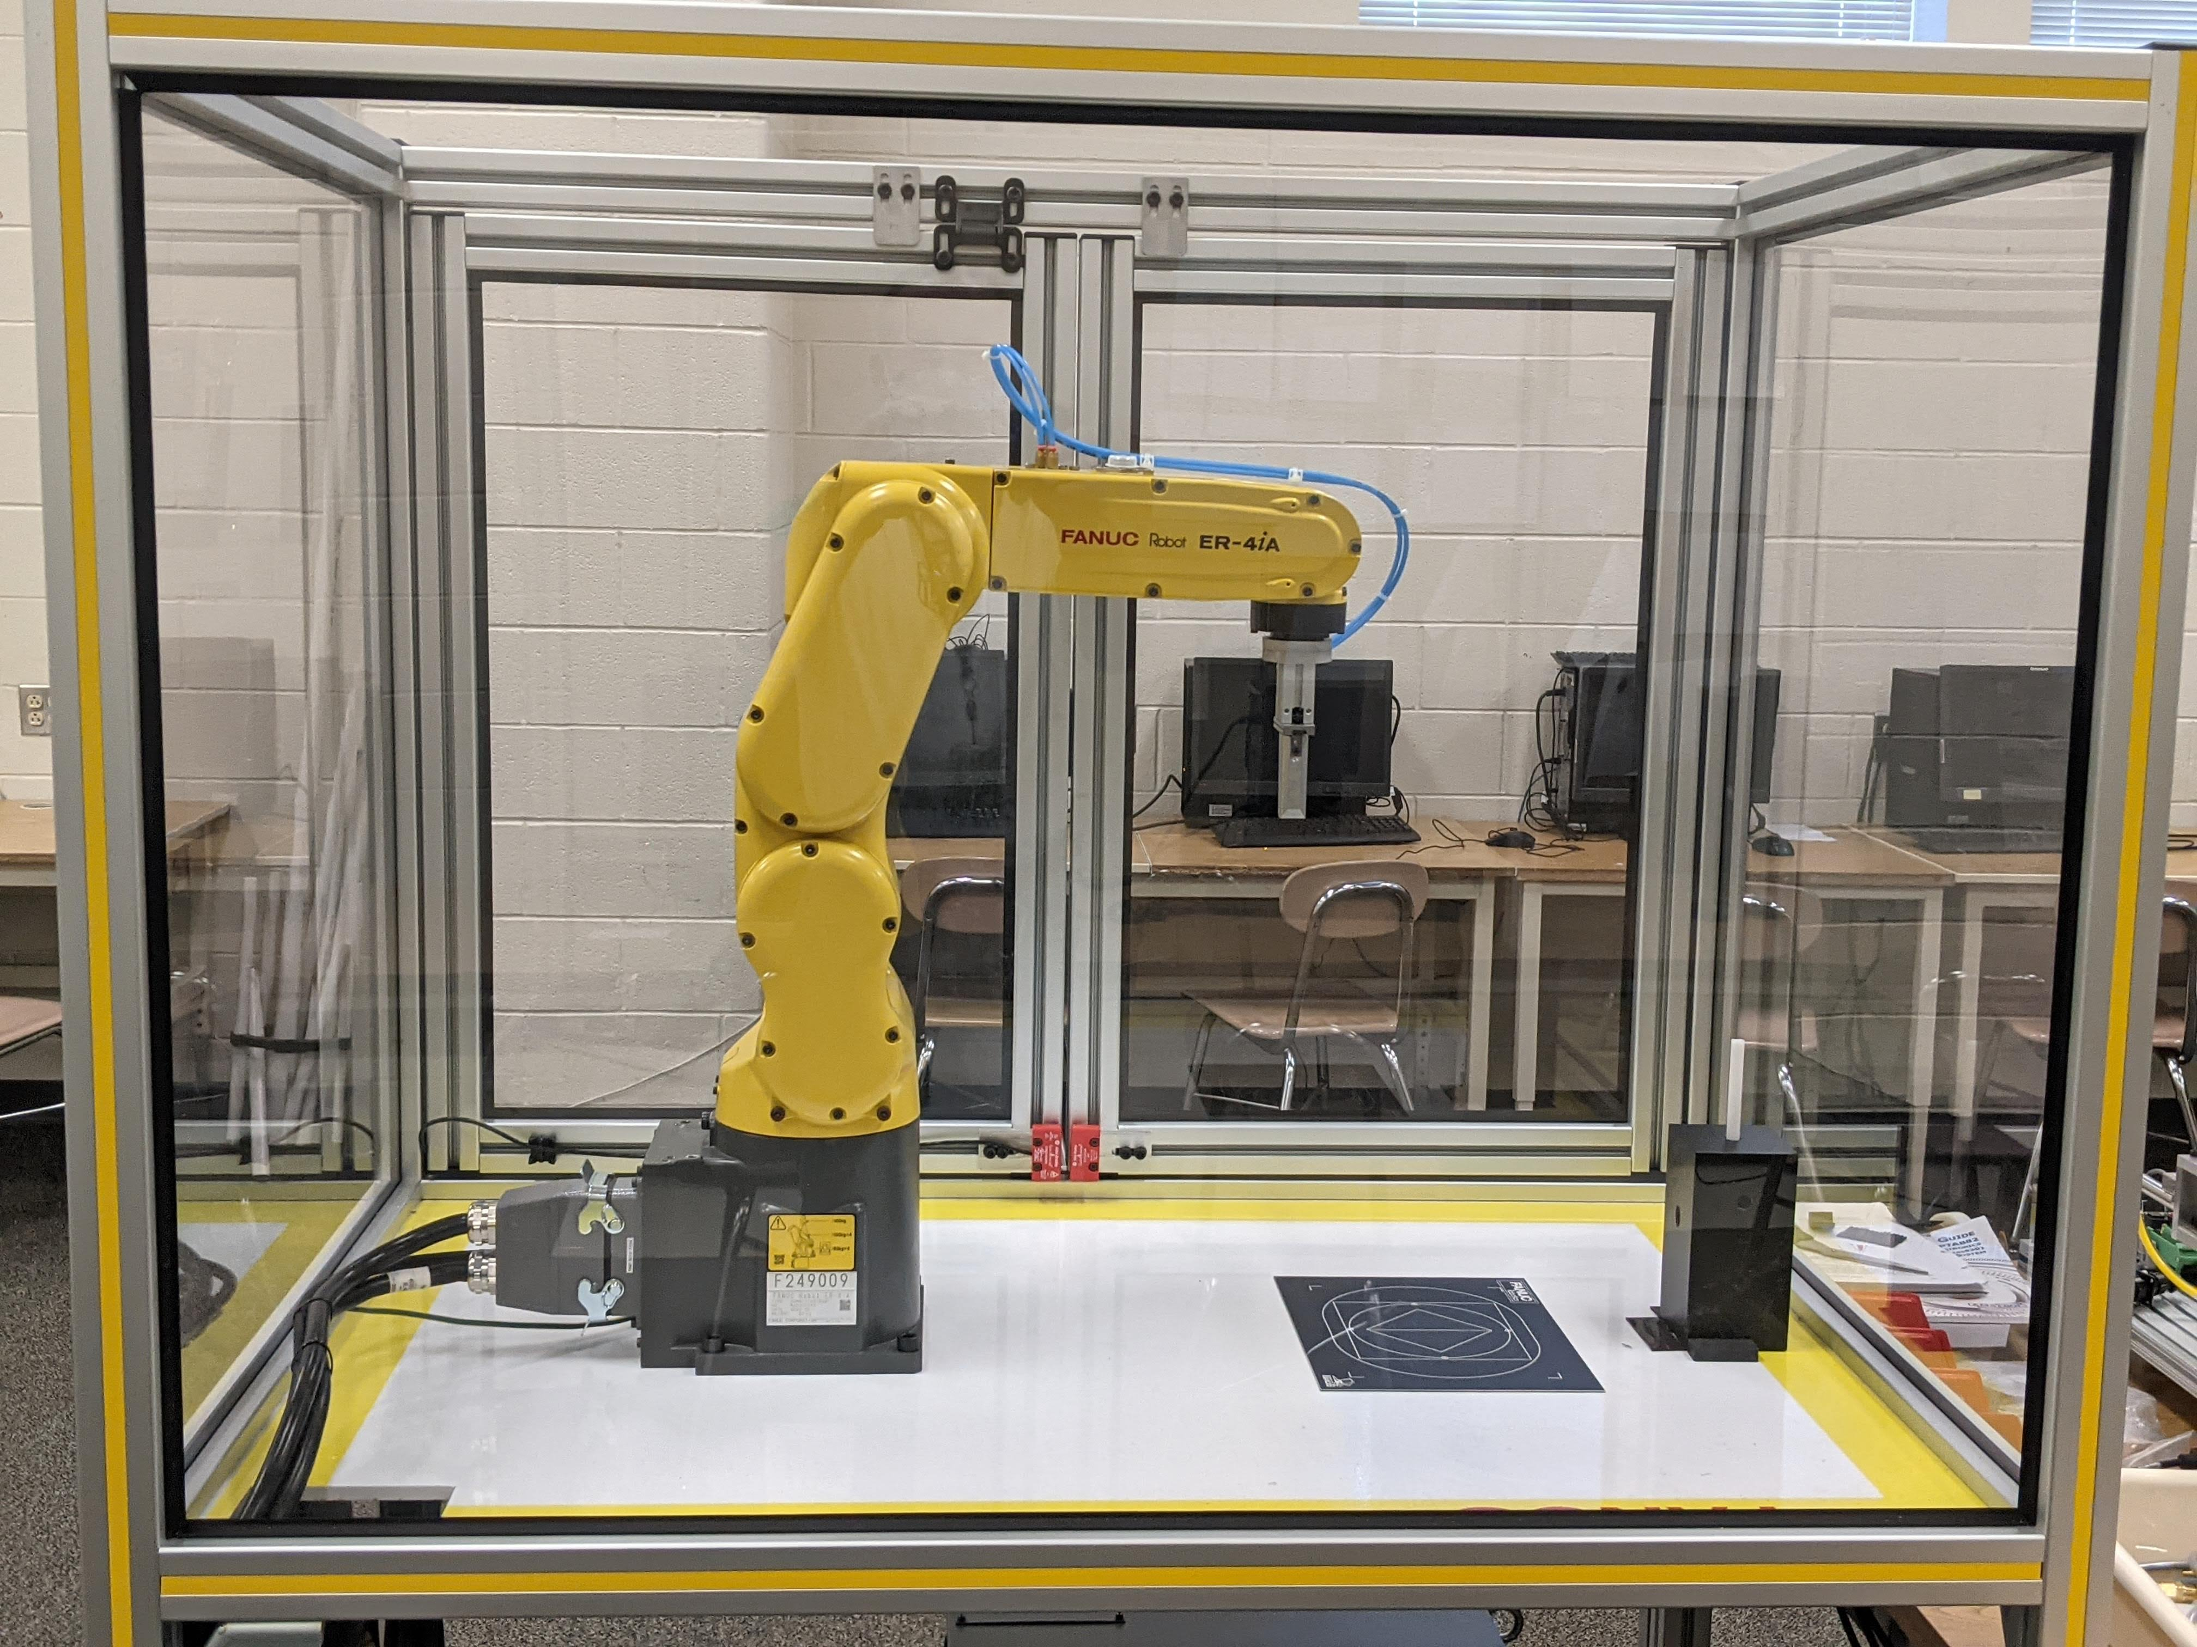
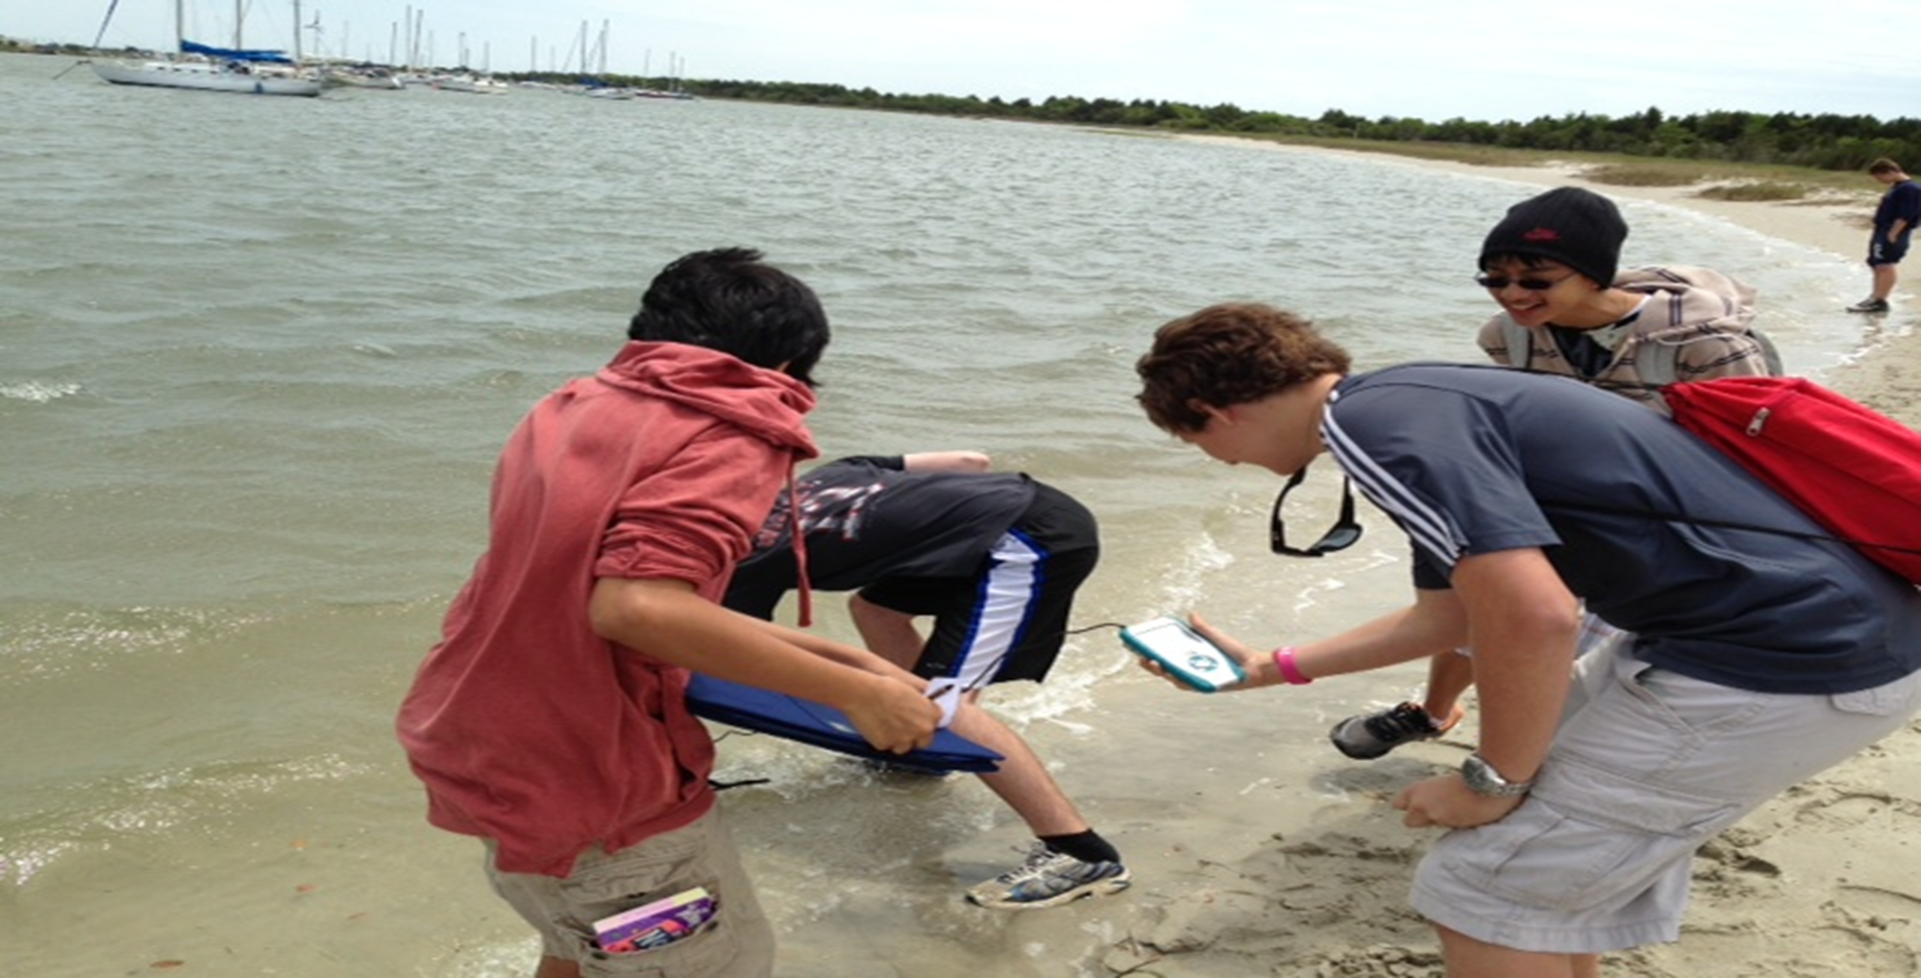
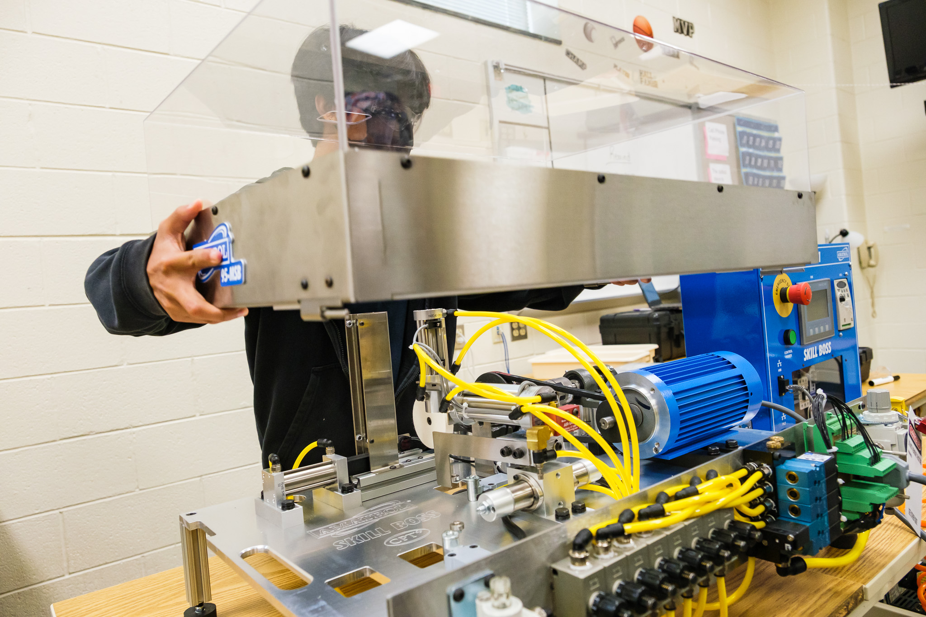
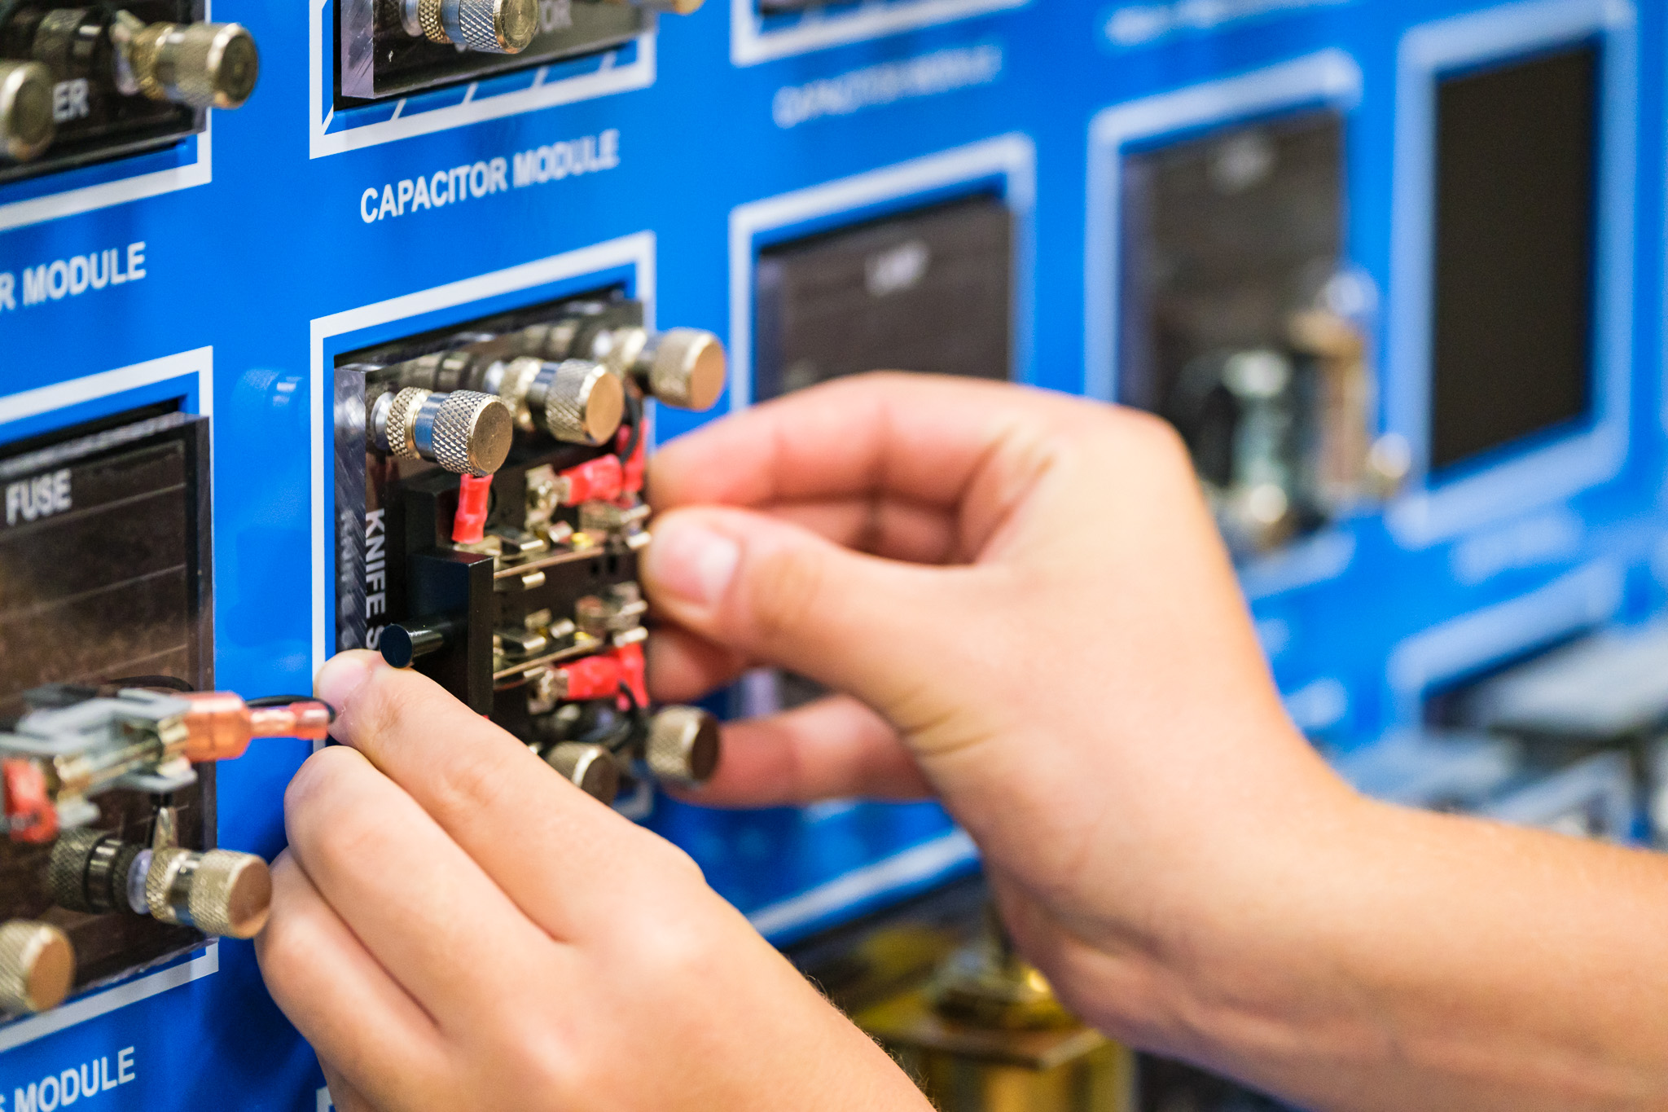
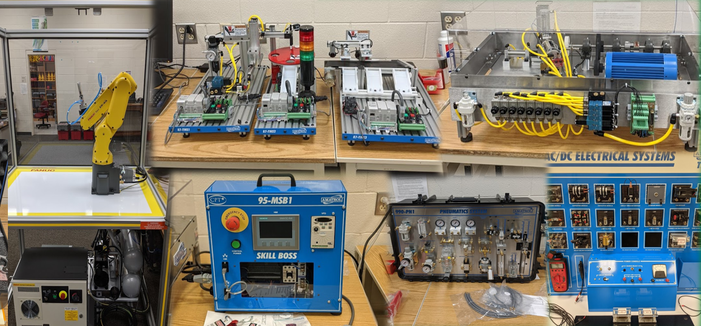
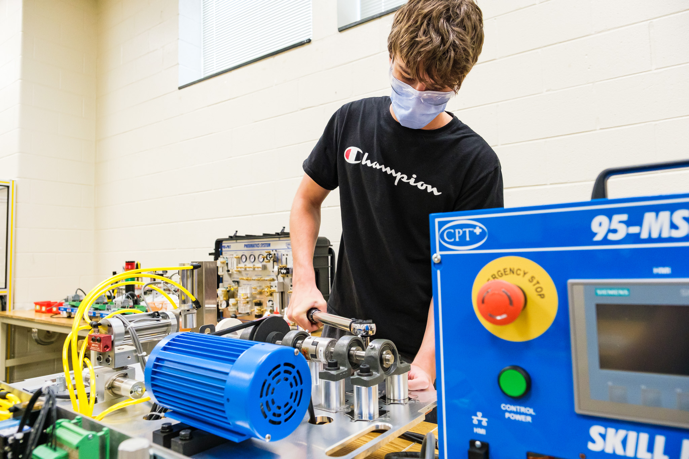
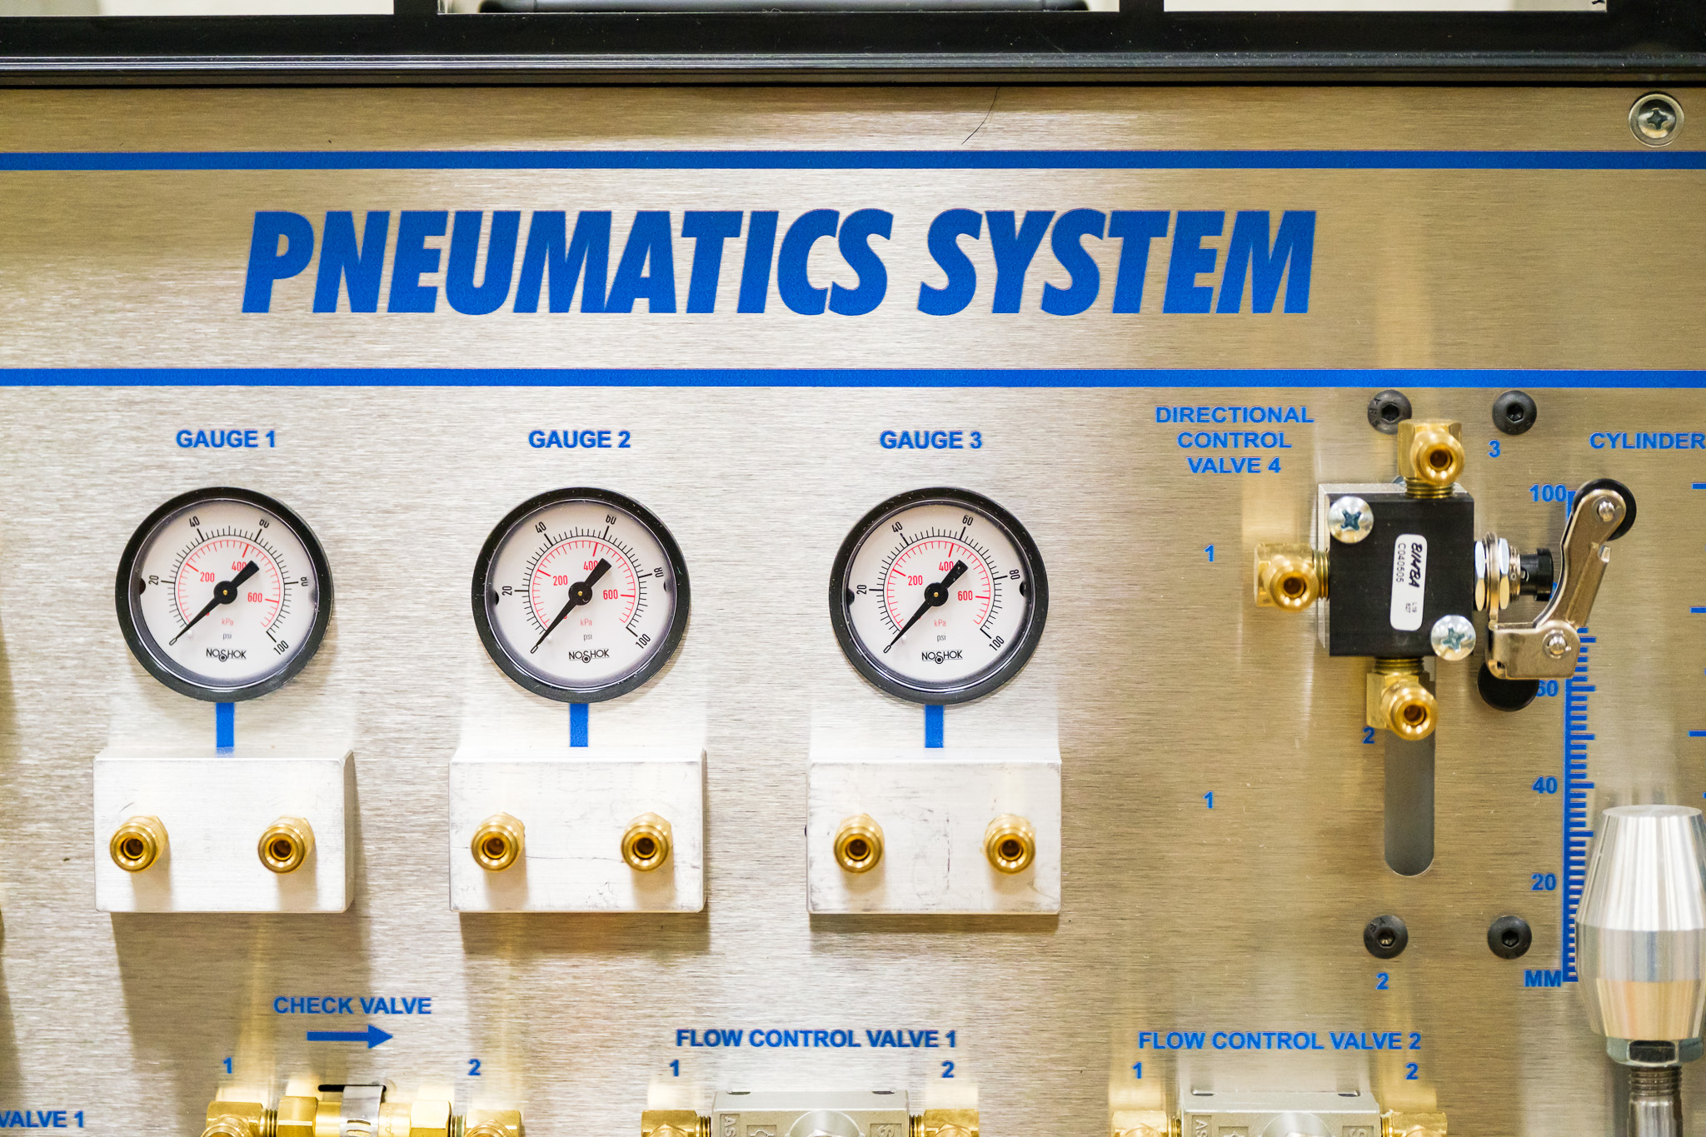
The Academy of Technology and Advanced Manufacturing Experience

Slide 16
Everyone Is Welcome!!
The Academy of Technology & Advanced Manufacturing is for everyone!
Students will exit the academy with skills that will help them for the rest of their life!

Slide 17
How do I Join the Academy of Technology and Advanced Manufacturing?
If you are interested in being part of this exceptional program or need more information to make an informed decision scan the QR Code below or contact Mr. John Evans via email at jevans3@wcpss.net
Academy Director – John Evans
Email: jevans3@wcpss.net Cary High School
919 460-3549 Ext. 21832

Slide 18
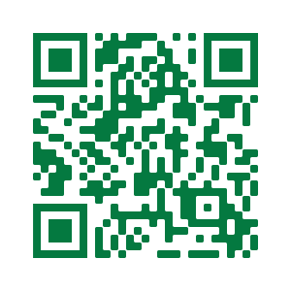
How do I get Involved With the Academy of Technology and Advanced Manufacturing?
If you are interested in being a member of the academy Advisory Board or Support Team then scan the QR Code below or contact Mr. John Evans via email at jevans3@wcpss.net
Academy Director – John Evans
Email: jevans3@wcpss.net Cary High School
919 460-3549 Ext. 21832

